Slide 1
VISUAL C#.NET session 9
Instructor: Edwin oduor

Slide 2
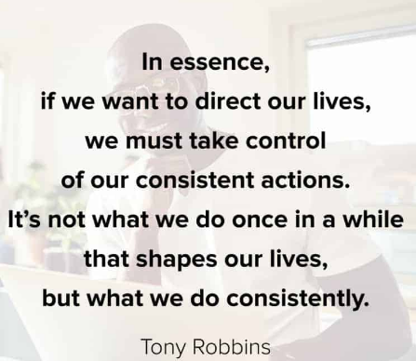
Quote of the day

Slide 3
Lesson objectives
Defining Arrays
Setting up Arrays
Working with Arrays and loops

Slide 4
Lesson pre-requisites
In order to take full advantage of this section you need to have the following;
Computer with Visual Studio Installed.
Stable Network Connection.

Slide 5
Training methods and extra readings
TRAINING METHODS FOR THIS LESSON
EXTRA READINGS
Lecturing Method – This is the main method of training to be adopted in this lesson with illustrations and practical coding examples.
Discussion Method - This method will be adopted periodically whereby learning will be derived principally from the students brainstorming together, rather than from the trainer. Three main types of discussions will be used:
Directed discussion
Developmental discussion
Problem-Solving discussion
Home and Learn C#

Slide 6
ARRAYS

Slide 7
WHAT is AN ARRAY

Slide 8
We have been working with variables whereby we set a variable and initialize the value with either a number of a bunch of string characters. Arrays on the other hand gives one the option to initialize a number of values be it integers, strings etc. all at once, rather than having to declare and initialize one after the other. This is a concept whereby a programmer can manipulate what the user has entered into the textbox to the developer’s desired choice.

Slide 9
SETTING UP AN ARRAY

Slide 10
Setting up an Array
int [] Numbers = new int [5];
When setting up an array start with the data type then the square bracket that is what shows that its an array, then the name of the array, use the new key word, the data type again lastly the number of elements that the array is going to hold. After setting up the array the next thing is to initialize the values in array.

Slide 11
When initializing the array, the first index is usually Zero as shown below.
Numbers [0] = 10;
Numbers [1] = 2;
Numbers [2] = 15;
Numbers [3] = 33;
Numbers [4] = 27;
Arrays can still be declared like this.
int [] Numbers = new int [5] {10, 2, 15, 33, 27};
To print out the array, then one writes the name of the array with the index i.e.,
MessageBox.show(Numbers [0]) this will print what is inside the first index which is 10.

Slide 12
ARRAYS & LOOPS

Slide 13
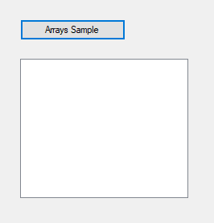
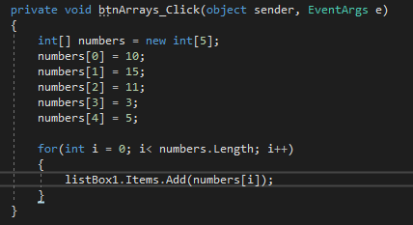
Suppose we have so many elements in the array and we want to print the elements all at once by clicking on the button then what will do will write the code using a loop so that all the elements inside the array are printed.
Will create a simple program to demonstrate this, Inside the button will have the following code.

Slide 14
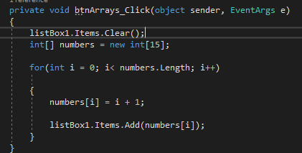
From the code in the previous slide, we are creating an array, initializing the values in the array, then introducing a for loop so that all the elements inside the array is printed out, you will notice that instead of using the name of the array with the index value what is happening is that we are using the loop i.e., numbers[i];
Suppose we have so many numbers what can be done is use the loop to assign values in the array. Our code is now going to look like this.
A
B

Slide 15
A
B
A – code labelled A what it does is to clear the list box before any numbers are displayed in the list box.
B – code labelled B using the loop to assign values in the array.
The Out put will as shown below once the button has been clicked on.

Slide 16
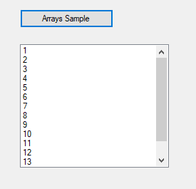
The Out put will be as shown below once the button has been clicked on.

